Slide 1

COVID-19
Twitter & WHO
BAN 675
Christina B.

Slide 2
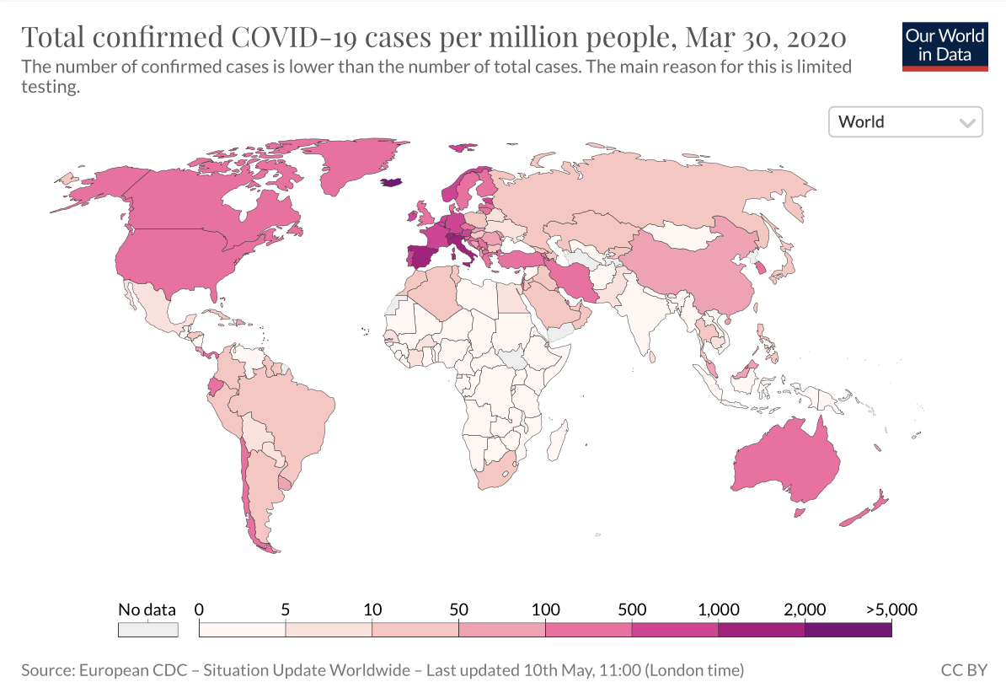
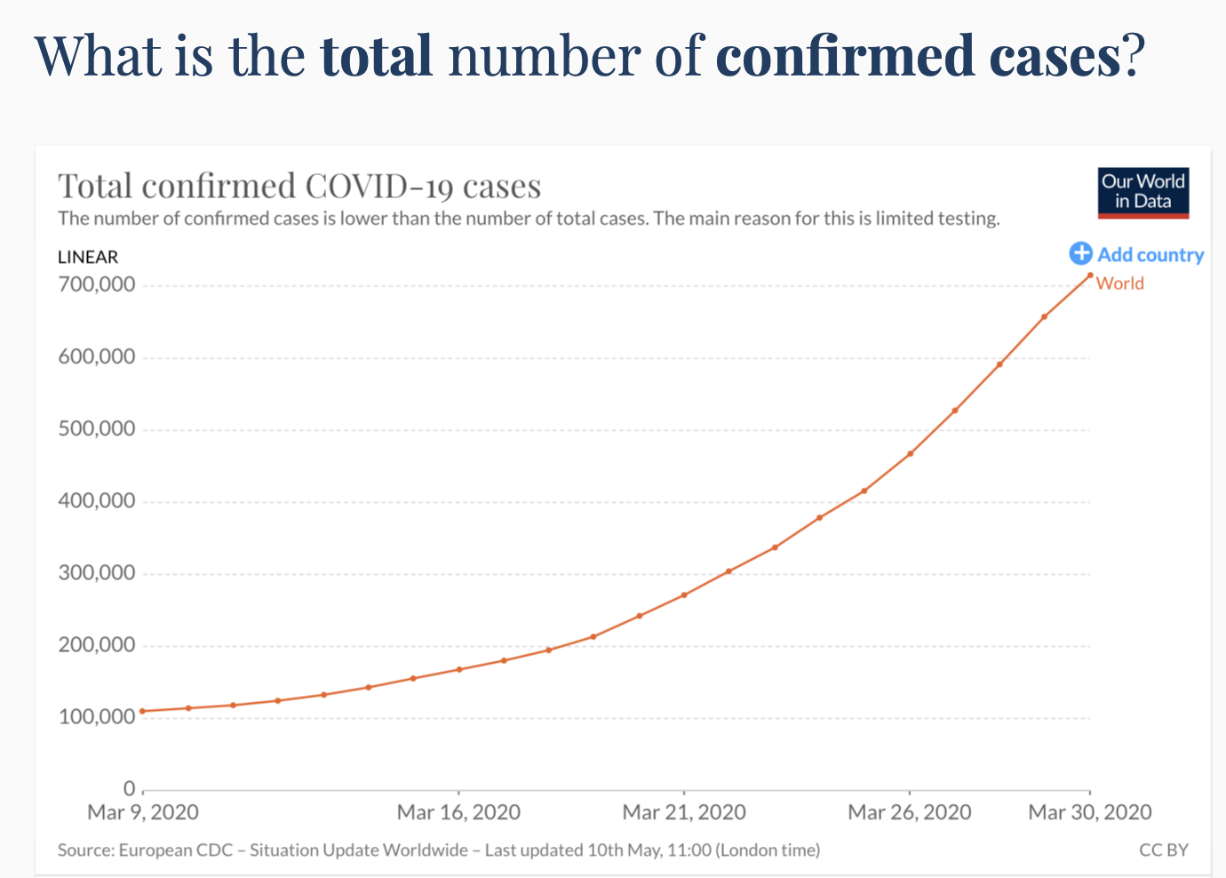
Context
Over 700k confirmed cases worldwide March 30th,2020
WHO declares the coronavirus outbreak a pandemic
Source : https://ourworldindata.org/covid-cases

Slide 3

AGENDA:
PURPOSE FOR ANALYSIS
STEPS INVOLVED
RESEARCH QUESTIONS ANALYZED
CONCLUSIONS DRAWN

Slide 4

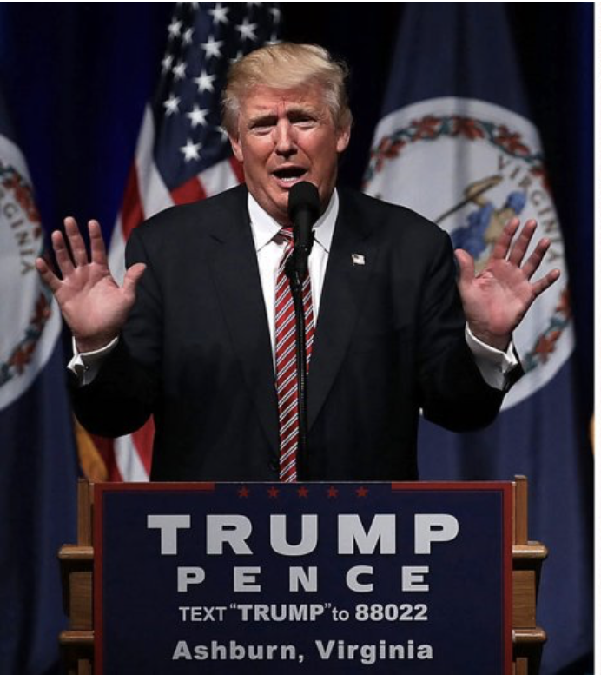

PURPOSE
How did Twitter react to Covid-19?
Do the WHO reports influence how the public tweets about COVID-19?

Slide 5
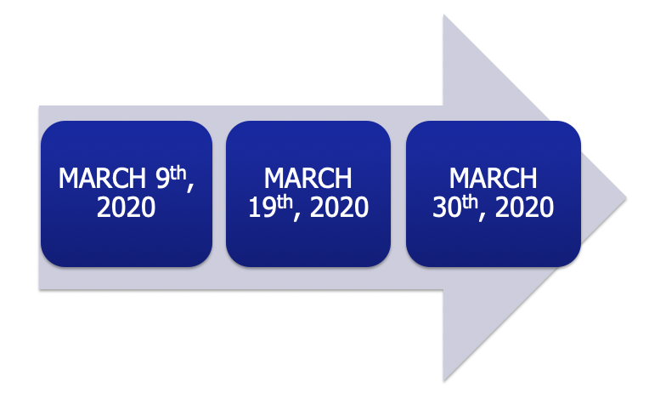
Data source
Covid-19 is declared as a pandemic
Over 700k confirmed cases
Shelter-in-
place order

Slide 6
Methods of Analysis
Topic Modeling
Sentiment Analysis
Used to find top topics surrounding COVID-19 at different periods of time
Analyze how the public negatively or positively responds to actions to slow the spread of COVID-19
Word Frequency
Text Visualization
Used to find the top words to describe COVID-19 at different periods of time
Used word clouds to display top phrases used during the pandemic

Slide 7
March 9th
Individual States declare States of Emergency.

Slide 8
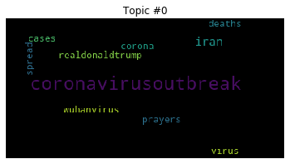
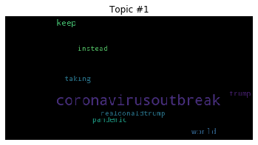
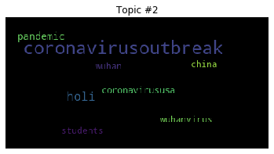
Topic Modeling on March 9 Tweets
Topic #0: Weak concentration of other topics outside of the initial outbreak and growing number of cases
Topic #1: More topics around Donald Trump’s response
to the outbreak
Topic #2: Tweets about the outbreak in China, growth in tweets about the outbreak related to the United States

Slide 9
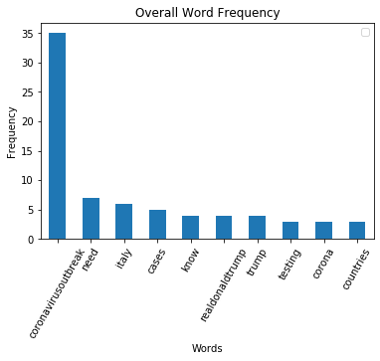
Word Frequency on March 9 Tweets
Word Included:
‘Coronavirusbreakout’
‘Italy’
‘Cases’
‘Countries’
Suggests:
Rising public awareness of the virus
Increase spread into other countries

Slide 10
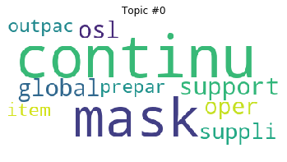

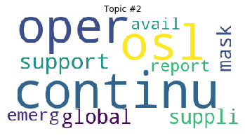
Topic Modeling on WHO Reports
Topic #0: Support and preparation for needed supplies
Topic #1: Support for supplies such as gloves and masks
Topic #2: Continued OSL (operation support and logistics)

Slide 11
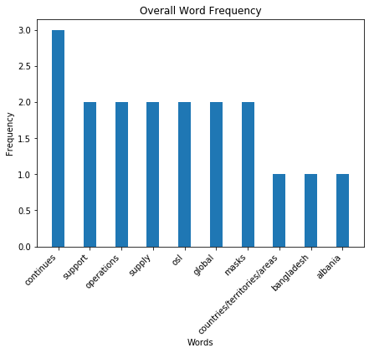
Word Frequency and Sentiment on WHO Reports
Word Included:
‘continues’
‘support’
‘supply’
‘global’
‘masks’
Suggests:
Information on COVID-19 cases and global support and supply needs

Slide 12
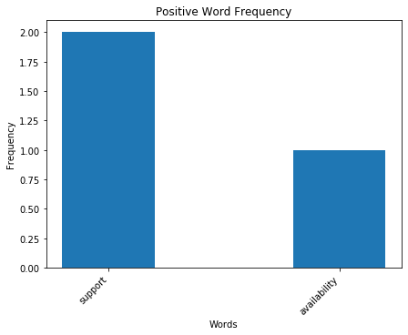
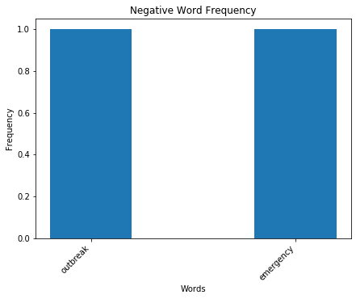
Word Frequency and Sentiment on WHO Reports
Suggests: Support is available in countries of outbreak. The word emergency has negative connotations, but stresses the level of importance the virus should be held to.

Slide 13
March 19th
COVID-19 was declared a pandemic.
Many states initiate lockdown.

Slide 14
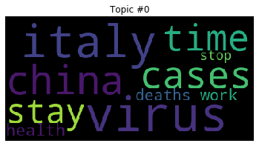
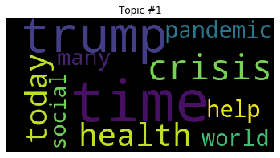
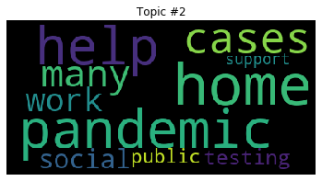
Topic Modeling on March 19 Tweets
Topic #0: Regions with largest impacts of the virus
Topic #1: Twitter users were tweeting about Trump and the fear people were experiencing
Topic #2: Twitter users were tweeting about the effects of the coronavirus

Slide 15
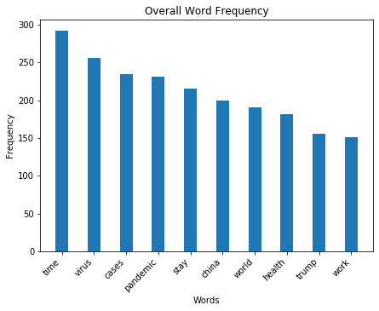
Word Frequency on March 19 Tweets
Word Included:
‘safe’
‘support’
‘care’
‘thank’
Suggests:
sense of safety
protecting health
showing appreciation

Slide 16
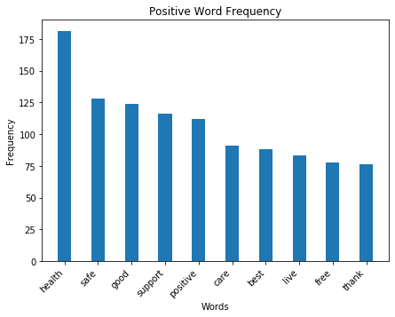
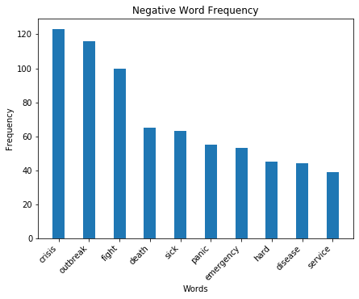
Word Frequency and Sentiment on March 19 Tweets
Suggests: people are concerned for their health and safety but are also appreciative
Note: ‘health’, ‘safe’, and ‘good’ were more frequently tweeted than words such as ‘crisis’, ‘outbreak’, and ‘fight

Slide 17
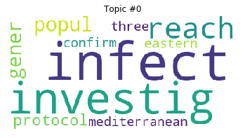
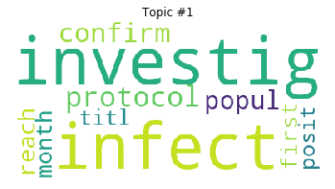
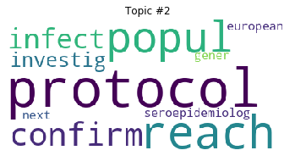
Topic Modeling on WHO Report
Topic #0: Investigations on the infections and newly affected areas
Topic #1: New records on the number of growing cases
Topic #2: Updated protocols and identifying antibodies

Slide 18
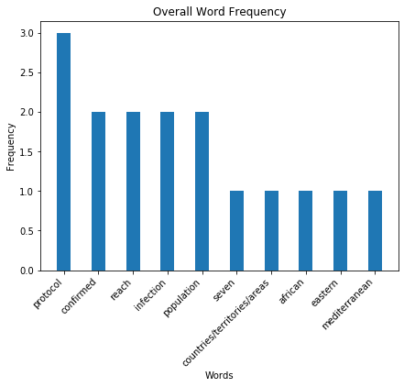
Word Frequency on WHO Report
Word Included:
‘protocol’
‘infection’
different regions such as ‘african’, ‘eastern’, and ‘mediterranean’
Suggests:
Informational and statistical data on Covid-19 cases in different areas
Change in protocol

Slide 19
March 30th
Lockdowns are extended nationwide.

Slide 20
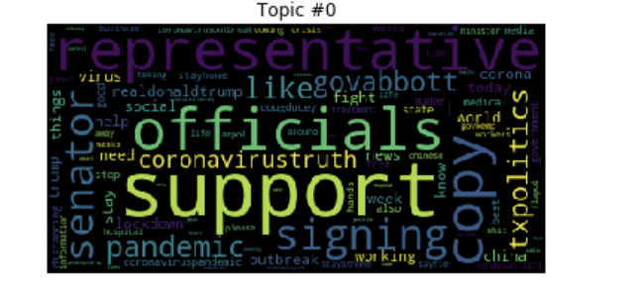
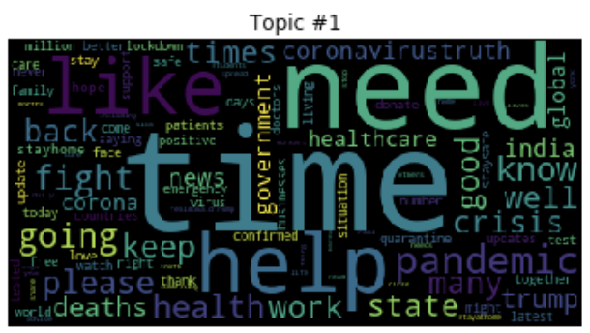
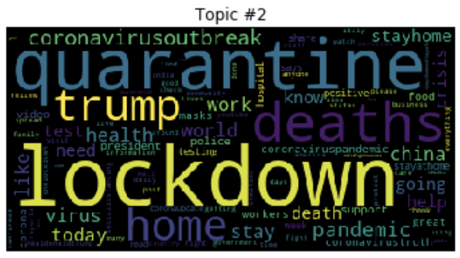
Topic Modeling on March 30 Tweets
Topic #0: Tweets surrounding COVID-19 is focused on politics and pandemic support
Topic #1: Tweets surrounding the need for aid
Topic #2: Tweets surrounding isolation in forms of quarantine and stay at home orders

Slide 21
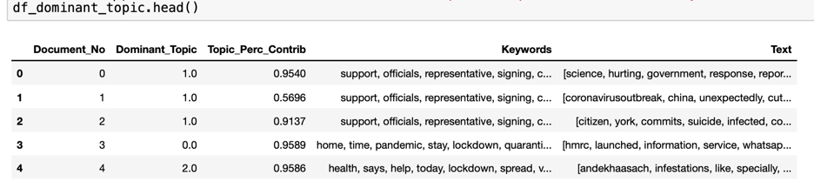
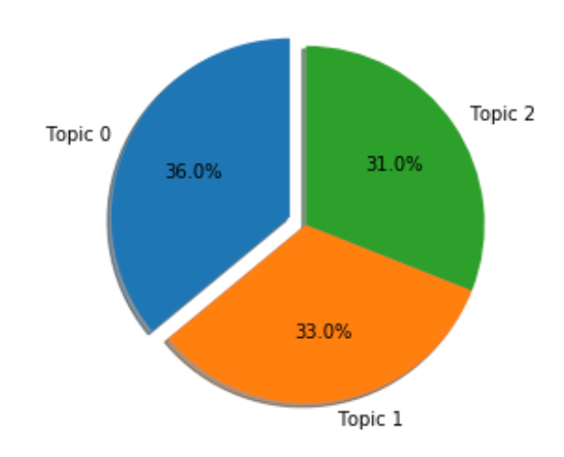
Topic Dominant on March 30
Takeaways:
People tweet about support, health concerns, and lockdown equally
The supportive tweets outweigh the negative tweets

Slide 22
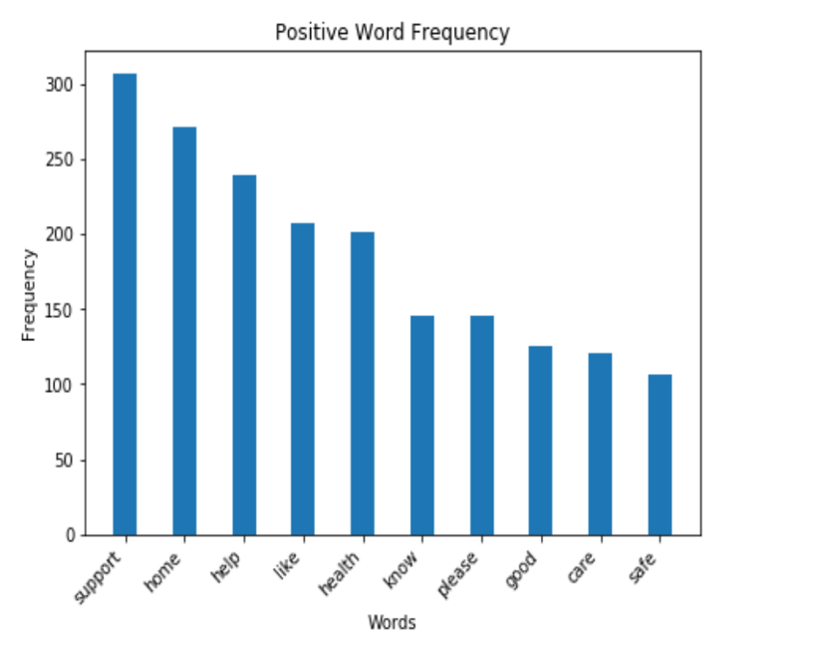
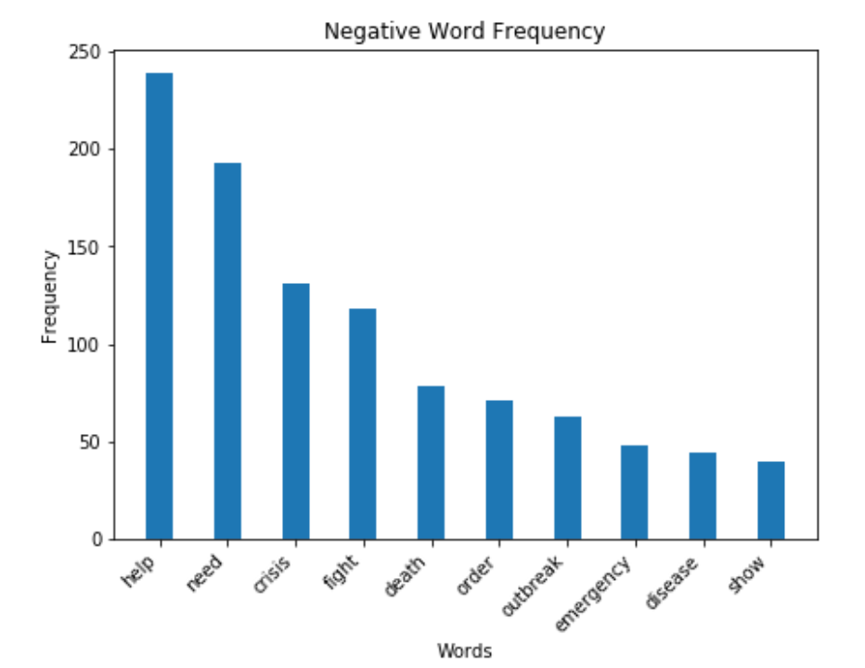
Word Frequency and Sentiment on March 30 Tweets
Suggests: The public remains supportive of stay at home, but further aid is needed to sustain people and businesses during the pandemic.

Slide 23
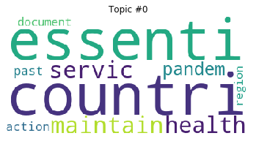
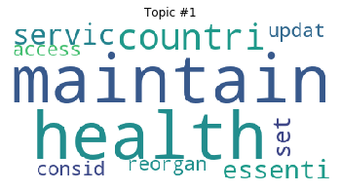
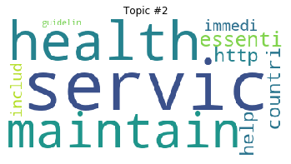
Topic Modeling on WHO Reports
Topic #0: Essential services and maintaining health in countries
Topic #1: Topics and maintaining health
Topic #2: Similar topics in maintaining health and services

Slide 24
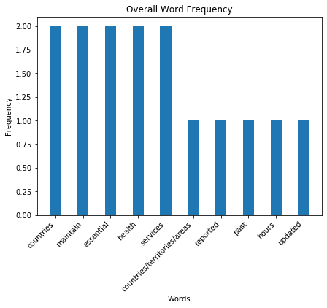
Word Frequency and Sentiment on WHO Reports
Word Included:
‘countries’
‘maintain’
‘health’
‘services’
Suggests:
Information suggest Covid-19 cases in different areas still continue

Slide 25
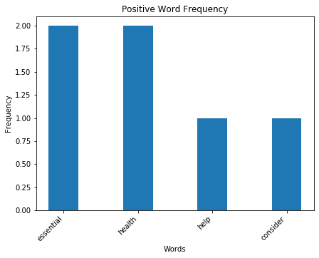
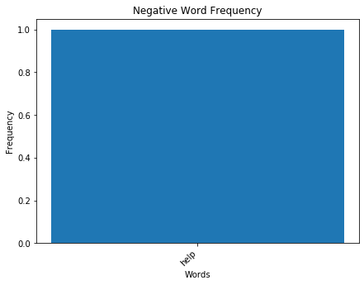
Word Frequency and Sentiment on WHO Reports
Suggests: The report has more positive than negative words. The word ‘help’ is shown both as a positive and negative word, so we look to sentiment analysis.

Slide 26
Takeaways

Slide 27
WHO Report Influence on Tweets
Pre-Lockdown
Initial Lockdown
Extended Lockdown
The WHO declared the virus an outbreak and an emergency by reporting the number of cases occurring around the world.
Tweets suggest growing awareness of COVID-19 and the rate at which is spreads.
The WHO reports include more positive than negative connotations on prevention.
There is a similar proportion of positive connotation in tweets (thanking others, offering support, promoting safety) outweighing tweets on death and infection.
The WHO reports very few negative words, likely supporting continued lockdown.
Tweets suggest continued support of safety by staying at home, however there is an increasing outcry for additional aid.

Slide 28
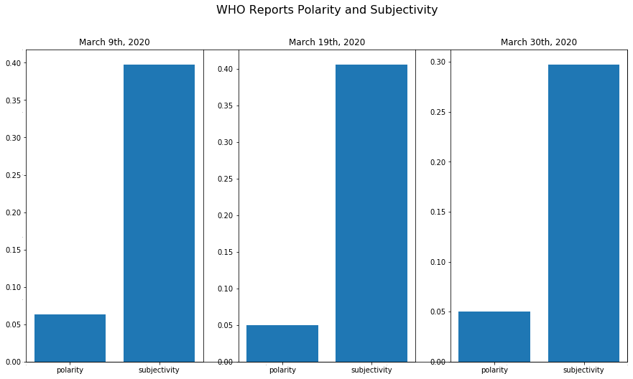
WHO Sentiment Analysis Trend
The WHO reports only varied slightly each day to the next in polarity and subjectivity.
On average the polarity was 0.05 meaning the emotion within the report is generally neutral.
On average the subjectivity was 0.37 meaning the reports are slightly more objective.
Overall, the reports are simply facts on daily activity of COVID-19.

Slide 29

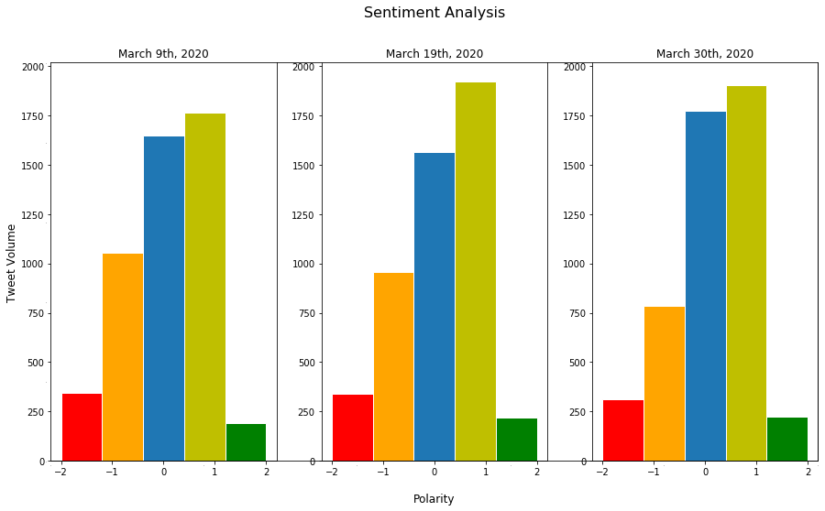
Twitter Sentiment Analysis Trend
In a random sample size of 5,000 tweets per day the level of emotion changes over the three selected days:
Extremely negative tweets were consistent
Gradual decrease in slightly negative tweets
Neutral tweets were lowest during the start of lockdown
Slightly positive tweets are highest at lockdown announcement
Extremely positive tweets are consistent
-1 -0.5 0 0.5 1 -1 -0.5 0 0.5 1 -1 -0.5 0 0.5 1
Polarity

Slide 30
WHO reports have little influence on tweets
The emotional language used in tweets do not depend on the WHO’s reports. The WHO reports neutrality was stable each day, while the polarity of tweets varied.
WHO reports and tweets have similar topics
Key topics between WHO and tweets were for support and maintaining health. We see cohesion on relaying messaging on the importance of health and support of governments and other countries.

Slide 31
RESOURCES
Smith, Shane. “Coronavirus (covid19) Tweets.” Kaggle, Mar. 2020,
www.kaggle.com/smid80/coronavirus-covid19-tweets/data#2020-03-12%20Coronavirus%2Tweets.CSV. (accessed May 10, 2020)
World Health Organization. “COVID-19 Situation Reports.” World Health Organization,
World Health Organization, Mar. 2020, www.who.int/emergencies/diseases/novel-coronavirus-2019/situation-reports. (accessed May 10, 2020)

Slide 32
Thank you!

